Slide 1
EE351 Microcomputer and Microsystems
2025秋 EE351《微机原理与微系统》
姜俊敏
电子与电子工程系
Junmin Jiang
Department of electronic and electrical engineering

Slide 2
Chapter 4: Hardware Structure of Microcontrollers
Learning Objectives for This Chapter
4.1 Understand Structure and Operating Process of the Model Machine
4.2 Learn Internal Structure of a Microcontroller
4.3 Learn Microcontroller Memory
4.4 Learn Microcontroller Pin Usage (I/O Port Utilization)
4.5 Learn Typical Configuration of Microcontroller Application Systems

Slide 3
4.1 Structure and Operating Process of the Model Machine
4.1.1 Structural Overview of the Prototype Machine
Structural Model of a Microcomputer (model machine)
Model Machine Main Components:
Three-bus(Address bus, data bus, and control bus)
Central Processing Unit（CPU）
Memory
I/O interface

Slide 4
4.1.1Structural Overview of the Prototype Machine
8086
Assembly language
Machine code
B0H 07H
MOV A, #07H
I/O interface
arithmetic unit control unit

Slide 5
4.1.1 Introduction to Structure of the Model Machine
1、Components of the Central Processing Unit
The central processing unit (CPU) consists of arithmetic unit and control unit.
（1）Arithmetic unit
Definition: The arithmetic unit is the functional component in a computer responsible for processing and manipulating data.
Function: Processing data primarily involves arithmetic and logical operations, such as addition, subtraction, multiplication, AND, OR, and NOT operations. It also temporarily stores data involved in operations and intermediate results.

Slide 6
1、Components of the Central Processing Unit
Components of Arithmetic unit
ALU(Arithmetic Logical Unit)：primarily performs arithmetic and logical operations.
Accumulator register (abbreviated as accumulator)A(Accumulator)：used for storing operands or operation results.
Register Set：composed of other registers, primarily used to store operands or calculation results.
Signal Register F(Flag)：Flags indicating the result of an operation (zero, sign, carry, overflow, etc.).

Slide 7
1、Components of the Central Processing Unit
（2）Controller
Function：The controller is responsible for coordinating the actions of various functional components within the computer to execute program functions.
Controller Components
PC(Program Counter)：used to store the address of the instruction to be fetched, after the instruction (address) is fetched, its content is automatically incremented by 1.
AR(Address Register): store operand (result) unit address
DR(Data Register)：used for storing operands。
IR(Instruction Register): store Instruction Opcode。
ID(Instruction Decode)：used to translate the instruction's opcode into a machine-recognizable command signal.
MOSG(Microoperation Signal Generator ): used to generate a series of micro-operation control signals.

Slide 8
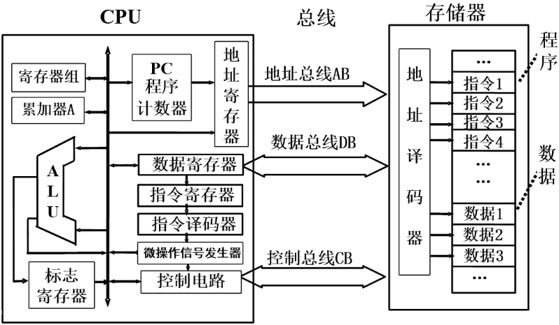
4.1.1 Introduction to Structure of the Model Machine
2、Memory Structure
Function：Primarily used for storing programs and data.
Components：Include Address Decoder、storage unit and control logic.
Memory Access Process：
（1）Read operation
The CPU first loads the contents of the address register AR onto the address bus AB，The contents on the address bus enter the address decoder，which decodes them and selects the corresponding memory cell.
The contents of the selected memory cell appear on the data bus. Under the control signal ，the CPU reads the data from the data bus into the data register DR，thereby completing the memory read operation.

Slide 9
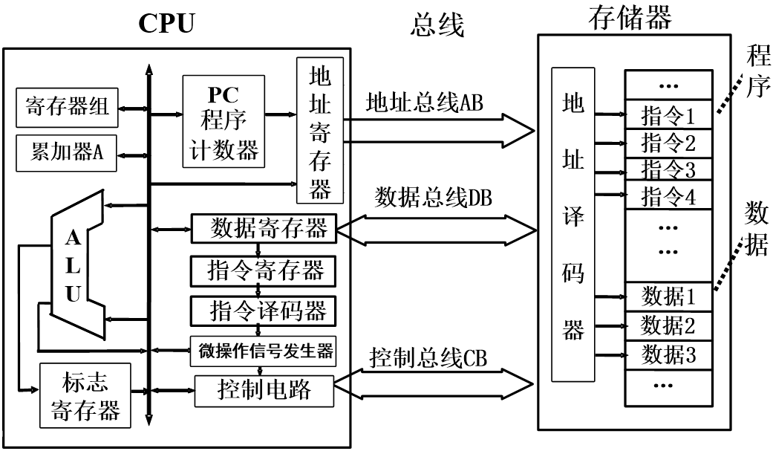
Memory Access Process
（2）Write operation
CPU transfers the contents of the address register AR onto the address bus AB. The data on the address bus enters the address decoder, which decodes it to select the corresponding memory cell. Under the control of signal signals, the CPU writes the data to be stored onto the selected memory cell via the data bus, completing the memory write operation.

Slide 10
4.1.2 The Working Process of the Model Machine : Perform computational control functions by executing instructions
Execution Process: Read Command→Analyze Command→Execute command→Save results
Before allowing the computer to perform calculations, the following tasks should be completed：
Write source code using mnemonic instructions (assembly language)；
Use assembly software (an assembler) to assemble the source program into a machine language program that the computer can recognize.；
Transfer data and programs into memory via input devices for storage.
For example，calculate 7+10=?，Put the results in A.
Microcomputer 8086
Assembly Language
Assembly language statements | Notes | Machine code
MOV A, #07H | ; 07 Load into accumulator A | B0H 07H
ADD A, #0AH | ; 10 is added to the contents of A, and the result is stored in A | 04H 0AH
HLT | ；Pause | F4H

Slide 11
For example，calculate 7+10=?，Put the results in A.
Address | Storage Content
00H | B0H
01H | 07H
02H | 04H
03H | 0AH
04H | F4H
Machine code
B0H 07H
04H 0AH
F4H
Assume the program's storage format in memory (with the program starting at address 00H) is as shown in the diagram.
The execution process of the instruction read phase is as follows：
①The CPU loads the contents of the program counter (PC) 00H into the address register (AR).
②The contents of the program counter (PC) automatically increment by 1 to become 01H, preparing to fetch the next instruction.
③Address register AR sends 00H via address bus AB to the memory address decoder for decoding, selecting cell 00H.
④The CPU issues a “read” command.
⑤The contents of selected cell 00, B0H, are transferred from memory to the data bus DB.
⑥Via the data bus DB, the CPU transfers the read content B0H to the data register DR.
Address Decoding

Slide 12
Work Process: Read Command→Analyze Command→Execute command→Save results
⑦The data register DR transfers its contents to the instruction register IR. After decoding, the CPU “recognizes” this opcode as the first byte of a two-byte instruction. It then fetches the next byte (machine code) and identifies it as the “MOV A, #07H” instruction. Consequently, the controller issues the control command to execute this instruction.
The aforementioned process of retrieving and decoding the finger must be repeated
Read the next machine code into A
加1
Decoding generates microcontroller commands
地址译码
Fig 3-4 Schematic Diagram for Reading the First Byte of the First Instruction
“MOV A, #07H”
machine code:B0H 07H

Slide 13
Schematic diagram of reading the second byte of the first instruction (executing the instruction)
“MOV A, #07H” (machine code:B0H 07H),
The process of retrieving machine code 07H:
Retrieve the next byte
Add 1
地址译码
Fig 3-5 Schematic diagram for executing the first instruction

Slide 14
Execute the second instruction “ADD A, #0AH”(machine code: 04H 0AH)
The instruction fetching process for executing the second instruction is identical to that of the first, differing only in the instruction code address.
Analysis (decoding) of the second instruction's opcode (first byte 04H) reveals it to be an addition instruction. The process for executing the second byte is as follows：
①Program counter PC contents (03H) load into AR.
②The contents of the program counter (PC) are automatically incremented by 1 and returned to the PC.
③The contents of the address register AR are sent via the address bus AB to the memory address decoder.
00H | B0H
01H | 07H
02H | 04H
03H | 0AH
04H | F4H
④The CPU issues a “read” command.
⑤The contents of the selected 03H cell, 0AH, are sent to the data bus DB.
⑥Data from the data bus DB is transferred to the data register DR.
Address Decoding

Slide 15
Execute the second instruction “ADD A, #0AH”(machine code: 04H 0AH)
⑦The contents of data register DR are transferred to register B, then to one end of the arithmetic logic unit (ALU).
⑧The contents of accumulator A are fed to the other end of the ALU to complete the addition operation.
⑨The result of the ALU addition is output to A.
Fig 3-6 Schematic Diagram for Executing the Second Instruction Operation

Slide 16
4.1.3 GCC Workflow
GCC Four-Step Detailed Explanation
Step One：Preprocessing (also known as precompilation) gcc -E hello.c -o hello.i
or cpp hello.c > hello.i 【cpp is a precompiler.】
Remove all #define directives and expand all macro definitions.
Process all conditional preprocessor directives, such as #if, #ifdef, #undef, #ifndef, #endif, and #elif.
Processing #include directives involves inserting included files at this location, which is a recursive process.
Remove all comments // /* */
Add line numbers and filename identifiers so that error warnings generated during compilation display line numbers.
Retain #pragma compiler directives
Step Two：Compilation gcc -S hello.i -o hello.s After performing a series of lexical analysis, syntactic analysis, semantic analysis, and optimizations on the preprocessed .i files, the corresponding assembly code files are generated. This constitutes the most critical and complex part of the entire program build process.

Slide 17
4.1.3 GCC Workflow
Step Three：Compilation gcc -c hello.s -o hello.o or as hello.s -o hello.o Assembly compiles the assembly code generated in the second step into machine-executable instructions, with nearly every assembly statement corresponding to a single machine instruction.
Step 4：Link
After linking dynamic libraries and static libraries, generate the executable file.
.o file: Object file
Object files are intermediate files produced after compiling source code but before linking. In Linux, .o files are object files. Object files and executable files share nearly identical content and format, so we can broadly consider them as one type of file. Both are stored in the ELF file format.

Slide 18
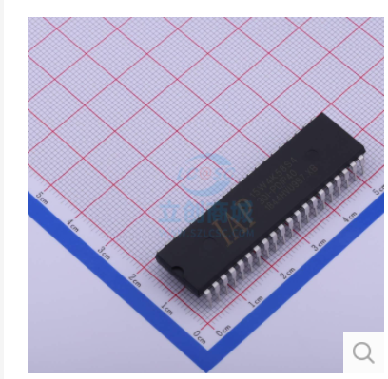
4.2 Internal Structure of a Microcontroller
A single-chip microcomputer (abbreviated as microcontroller) integrates the functional structure of the aforementioned microcomputer onto a single chip，
Some microcontrollers not only integrate conventional resources such as a CPU, memory for storing programs and data, system buses, I/O interfaces, and timers/counters, but also incorporate analog signal acquisition modules commonly used in industrial measurement and control systems.
IAP15W4K58S4 Operating Voltage：2.5V - 5.5V
STC15F2K60S2 Series Operating Voltage: 5.5V - 3.8V( 5V Microcontroller)
STC15L2K60S2 Series Operating Voltage: 3.6V - 2.4V( 3V Microcontroller)

Slide 19
4.2 Internal Structure of a Microcontroller
The 8051 core serves as the fundamental standard for the Intel 8051 series of microcontrollers. Many reference books refer to this microcontroller as the MCS-51 series microcontroller.
The MCS-51 series microcontroller is represented by the 8051, featuring 4K × 8-bit ROM, 128 bytes of RAM, two 16-bit timers/counters, four 8-bit I/O ports, one serial port, and 111 instructions.
In the 1980s, Intel sold the 8051 core to several prominent IC manufacturers, such as Philips and Atmel. As a result, the 8051 microcontroller gained support from numerous manufacturers and evolved into a large family of products numbering in the hundreds.
The most commonly used include the STC series microcontrollers from Macronix and the AT89 series from Atmel, both belonging to the 51 series. As long as they are 8051-core microcontrollers, their basic structures are identical, and their instruction sets are fully compatible with standard 8051 microcontrollers.

Slide 20
4.2 Internal Structure of the IAP15W4K58S4 Microcontroller
This course uses the enhanced 8051 core microcontroller IAP15W4K58S4 as an example to illustrate the internal structure of microcontrollers. See Fig 3-6
IAP15W4K58S4 incorporates nearly all the unit modules required for data acquisition and control，
——It can be considered a system-on-a-chip (SOC)

Slide 21
Block Diagram of the Internal Structure of the IAP15W4K58S4 Microcontroller

Slide 22
The IAP15W4K58S4 microcontroller integrates the following typical resources:
• Enhanced 8051 core, single-clock machine cycle, delivering speeds 8 to 12 times faster than traditional 8051-core microcontrollers.
• 58KB Flash program memory for storing user programs. For IAP-type microcontrollers, the portion of Flash not allocated for program storage can be used as data Flash to preserve parameters that must remain intact after power loss. The Flash memory supports over 100,000 erase/write cycles.
• 4096-bit SRAM, equivalent to computer memory, can be used to store variables used in programs.
• Five 16-bit auto-reloadable timers/counters (T0, T1, T2, T3, and T4) with programmable clock output functionality.

Slide 23
The IAP15W4K58S4 microcontroller integrates the following typical resources：
• Up to 62 I/O (input/output) port lines (64-pin package) for parallel data input and output.
• Four full-duplex asynchronous serial ports (UART) enable serial data transmission between the microcontroller and other devices.
• 1 high-speed synchronous communication port (SPI) for interfacing with SPI-enabled devices.
• Interrupt Control System. Features five external interrupt channels, capable of triggering circuits via falling edge interrupts or dual-edge (rising and falling edge) interrupts. In power-down mode, the system can be awakened by an external interrupt low signal.

Slide 24
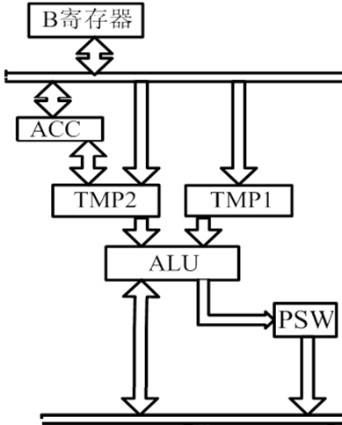
The central processing unit (CPU) consists of an arithmetic logic unit and a control unit
The central processing unit (CPU) of a microcontroller consists of an arithmetic unit and a control unit.
1. Arithmetic unit
Centered around an 8-bit arithmetic logic unit (ALU), the entire arithmetic logic unit's logic circuit comprises registers TMP1 and TMP2, the accumulator (ACC), register B, the program status word (PSW), and a Boolean processing unit, all interconnected via internal buses.
Program Status Word (PSW), also known as the status register

Slide 25
Program Status Word (PSW) (8 bits)
Some bits in the PSW are automatically set during instruction execution, while others can be modified by user-executed instructions.
The individual bits of the PSW are defined as follows：
Pin number | D7 | D6 | D5 | D4 | D3 | D2 | D1 | D0
Symbol | CY | AC | F0 | RS1 | RS0 | OV | F1 | P
CY
CY（PSW.7）：Carry Flag Bit
When executing addition/subtraction instructions, if the most significant bit D7 of the result carries or borrows, CY is set to “1”; otherwise, it is cleared to “0”.
After performing multiplication or division operations, the CY flag is cleared. Additionally, the CPU affects this flag during shift operations.
It also serves as the “accumulator” for bit operations performed by the bit processor.

Slide 26
Program Status Word (PSW) (8 bits)
Pin number | D7 | D6 | D5 | D4 | D3 | D2 | D1 | D0
Symbol | CY | AC | F0 | RS1 | RS0 | OV | F1 | P
AC
F0
F1
AC（PSW.6）：Auxiliary Carry Flag Bit (Auxiliary Carry)
When executing addition/subtraction instructions, if a carry/borrow occurs from the lower four digits to the upper four digits, the AC bit is set to “1”; otherwise, it is cleared.
F0（PSW.5）：User Flag Register (F0).
is a user-defined status flag. It can be set to “1” or cleared to “0” via software, and software can also test F0 to control program flow.
F1（PSW.1）：User Flag 1 (F1) .
is a user-defined status flag. It can be set to “1” or cleared to “0” via software, and software can also test F1 to control program flow.

Slide 27
Program Status Word (PSW) (8 bits)
Pin number | D7 | D6 | D5 | D4 | D3 | D2 | D1 | D0
Symbol | CY | AC | F0 | RS1 | RS0 | OV | F1 | P
RS1
RS0
OV
P
RS1,RS0（PSW.4～PSW.3）：Work register group selection control bit` follow。
OV（PSW.2）：Overflow flag. Indicates whether an overflow occurred during an operation; it is automatically set during instruction execution.
P（PSW.0）：Parity bit
The number of 1s in the accumulator ACC is even, P=0; otherwise P=1. Each instruction cycle is set to “1” or cleared to “0” by hardware.
In serial communication with parity checking, the parity bit can be set according to P.

Slide 28
Controller
The controller is the central nervous system of the CPU, including timing control logic, instruction registers, decoders, (data) address pointer DPTR, program counter PC, stack pointer SP, RAM address registers, and so on.
Program Counter
It is a 16-bit program address register, specifically used to store the memory address of the next instruction to be executed, and it automatically increments by 1.
When the CPU executes instructions, it retrieves the instruction code from memory based on the address provided by the PC, and then the controller decodes and analyzes it before execution.
Each time an instruction code is fetched, the PC automatically increments by 1. In this way, as the program counter PC increments repeatedly, instructions are executed one by one.

Slide 29
Controller — Stack
Primarily used for saving temporary data, local variables, and return addresses for interrupts or subroutines.
The stack for the IAP15W4K58S4 microcontroller is located in the internal RAM, and it is an area for storing data following the "First-In, Last-Out" (FILO) principle.
The Stack Pointer (SP) is an 8-bit register that can automatically increment by 1 or decrement by 1.
SP points to the top of the stack. When data is pushed onto the stack, SP automatically increments by 1 first, and then the data is pushed; when data is popped, the data is popped from the stack first, and then SP automatically decrements by 1.
Upon reset, the SP register defaults to 07H, meaning the stack area starts at address 08H. Users can typically use instructions to set the stack area within the internal RAM range of 80H to FFH.

Slide 30
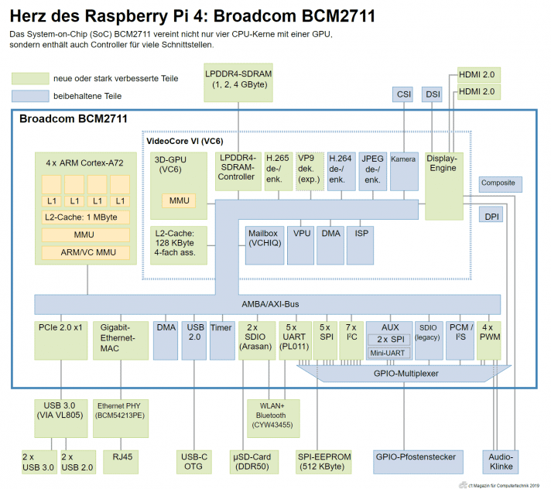
Broadcomm BCM2711

Slide 31
4.3 Memory of IAP15W4K58S4 Microcontroller
Structural Feature: The addressing spaces for Program Memory and Data Memory are separate.
Structural Division: The chip integrates 3 physically independent memory spaces: Program Flash Memory, Internal Data Memory, and Extended Data Memory.
Data is accessed using MOVC instruction
Accessed using MOV instruction
Physically on-chip, logically external, accessed using MOVX
Program Flash Memory

Slide 32
Data Memory
Data Memory is also known as Random Access Data Memory (RAM).
Space Segmentation
Physically and logically, the Data Memory is divided into two address spaces: Internal Data Memory and External Data Memory. 。
(1) Internal Data Memory (also referred to as Internal RAM)
The 256 bytes of Internal RAM stores intermediate results and process data. The Internal RAM address range is 00H～FFH, totaling 256(+128) units, segmented into three parts:
①Lower 128 Bytes of RAM (00H～7FH)
②Upper 128 Bytes of RAM（80H～FFH）
③Special Function Register (SFR) Area: Address range is 80H～FFH
Address Overlap
distinguished by Addressing Mode

Slide 33
Data Memory
(1) Detailed Introduction to the Three Segments of Internal Data Memory (a.k.a. Internal RAM):
①128 Bytes of RAM (00H～7FH)：Also known as the Base RAM Area. The Base RAM Area is further divided into Register Banks, the Bit-Addressable Area, User RAM, and the Stack Area.
Supports Direct Addressing and Register Indirect Addressing. Accessed using instructions in the form of "MOV direct" and "MOV @Ri".
②128 Bytes of RAM(80H～FFH):Can only be accessed via Indirect Addressing. Accessed using instructions in the form of "MOV @Ri".
③Special Function Register (SFR):Area: Address range is80H～FFH，Can only be accessed via Direct Addressing, accessed using instructions in the form of "MOV direct".
MOV A, 38H
MOV A, @R0

Slide 34
Working Register Banks
Example: “MOV A, @R0” (Opcode E6)
Address Allocation:00H～1FH , totaling 32 units. Divided into four banks (each bank is called a Register Bank), with each bank including 8 x 8-bit working registers, namely R0 ~ R7.
Function: Using the working registers can increase computation speed, and R0 or R1 can also be used to store an 8-bit address value to access an element in a 256-byte (logically external) RAM block.
Furthermore, R0~R7 can also be used as counters, performing increment by 1 or decrement by 1 under instruction control
Indirect Addressing Mode “ MOV(X) @Ri ”
Register Bank 3(R0~R7)
Register Bank 2(R0~R7)
Register Bank 1(R0~R7)
Register Bank 0(R0~R7)
18H~1FH
Increment Instruction “INC R0”
Increase R0 by 1
Decrement Instruction “DEC R0”
Decrease R0 by 1
10H~17H
08H~0FH
00H~07H

Slide 35
User RAM and Stack Area
The memory units from 30H to 7FH in the internal RAM constitute the User RAM and Stack area.
There is an 8-bit Stack Pointer (SP), and the stack area can only be set within the internal data memory. When a subroutine is called or an interrupt is requested, information such as the return address is automatically saved in the stack.
After a reset of the IAP15W4K58S4 microcontroller, the SP is 07H, causing the stack to effectively start from memory unit 08H (SP is incremented by 1 before data is pushed onto the stack, then the data is pushed).
Considering that memory units 08H to 1FH belong to Working Register Banks 1 to 3, if these working registers are used in the program, it is best to change the SP value to 80H or greater in the user initialization program.
The stack of the IAP15W4K58S4 microcontroller grows in the direction of increasing addresses, meaning that after a data push operation, the SP value increases (SP is incremented by 1 first, then the data is pushed).

Slide 36
Upper 128 Bytes of RAM and Special Function Registers
For the IAP15W4K58S4 microcontroller, the 80H to FFH RAM (Upper 128 Bytes) area shares the same address range with the Special Function Register (SFR) area. Their address spaces overlap, but they are physically independent.
When in use, they are distinguished by different addressing modes: the upper 128 bytes of RAM are accessed using indirect addressing, while Special Function Registers are accessed using direct addressing.
Since stack operations use the Stack Pointer (SP) as an indirect register for indirect addressing, the upper 128 bytes of data RAM can also be used as a stack area.
Apart from the Program Counter (PC) and the four Working Register Banks, all other registers are located in the SFR area.

Slide 37
Special Function Registers (SFRs)
Special Function Registers are broadly categorized into two types:
①One type is related to the chip's pins. For example, P0~P7 are actually 8 latches, and each latch, equipped with its corresponding output driver and input buffer, forms a parallel port.
②Another type consists of registers for controlling internal chip functions or internal registers. Examples include registers related to interrupt masking and priority control, timers, serial ports, SPI interfaces, and so on.

Slide 38
(2) on-chip expanded RAM(XRAM)
The external data memory area is also known as the expanded RAM (XRAM) area. The IAP15W4K58S4 microcontroller can access a total of 64KB of expanded data memory space. The IAP15W4K58S4 microcontroller integrates 3840B of XRAM on-chip, with an address range from 0000H to 0EFFH, which can be used to store data.
Note that "internal" and "external" here are logical concepts relative to the 8051 core, not referring to the physical internal and external parts of the chip.
In assembly language, XRAM is accessed using the "MOVX @DPTR" or "MOVX @Ri" instructions.
In C language, you can declare the storage type using pdata or xdata.
Example ：unsigned char xdata i= 0;

Slide 39
(2) on-chip expanded RAM(XRAM)
When accessing the on-chip integrated external RAM, it does not affect P0, P2, P4.2 (WR), P4.4 (RD), and ALE (P4.5). However, accessing externally expanded RAM will affect these port lines.
The IAP15W4K58S4 microcontroller can also access externally expanded 64KB external data memory.
The external expanded I/O ports of the IAP15W4K58S4 microcontroller share the same address space with the extended data memory. Therefore, the addresses of the external I/O ports occupy address units within the extended data memory, and external expanded I/O ports are also accessed using the MOVX instruction.

Slide 40
(2) on-chip expanded RAM(XRAM)
Whether the internal expanded RAM of the microcontroller is accessible is controlled by the EXTRAM bit in the auxiliary register AUXR (address 8EH, reset value 01H).
Bit No. | D7 | D6 | D5 | D4 | D3 | D2 | D1 | D0
Bit Name | T0x12 | T1x12 | UART_ M0x6 | T2R | T2_C/ | T2x12 | EXTRAM | S1ST2
EXTRAM：
0: Internal expanded RAM is accessible; when the address is less than 0F00H, access the internal expanded RAM; when the address is greater than or equal to 0F00H, access the microcontroller's externally expanded RAM or I/O space.
1: Access to internal expanded RAM is prohibited.
3840 bytes, address range from 0000H to 0EFFH

Slide 41
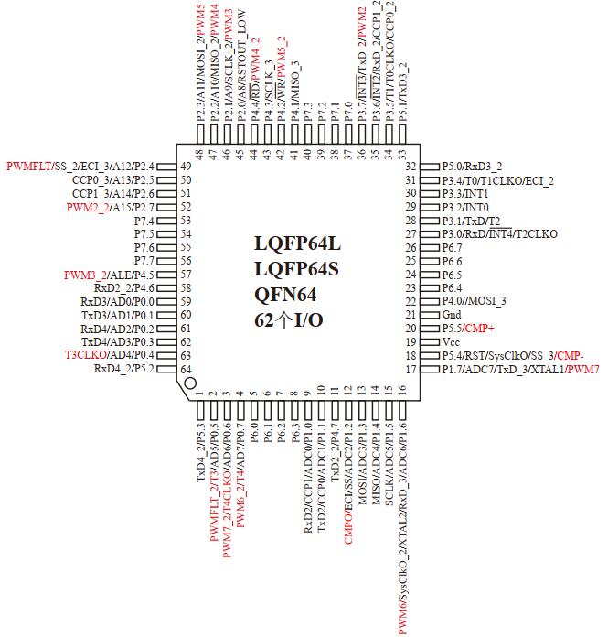
4.4Microcontroller Pins
4.4.1 Microcontroller Pins and Functions
Package
Input/Output Ports P0～P7
LQFP-64 Package
Low Profile Quad Flat Package

Slide 42
4.4 Microcontroller Pins
4.4.1 Microcontroller Pins and Functions
Package
Input/Output Ports P0～P5
LQFP-44 Package
Low Profile Quad Flat Package

Slide 43
Microcontroller Pins and Functions
Package
Dual In-line Package
Input/Output PortsP0～P5
DIP-40 Package
(Dual In-line Package)

Slide 44
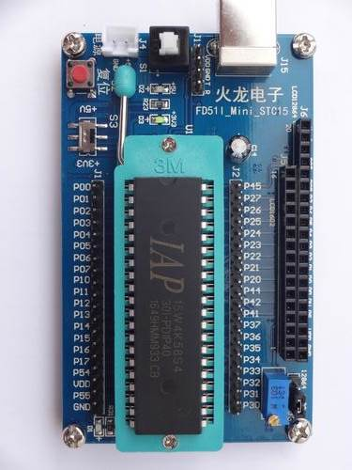
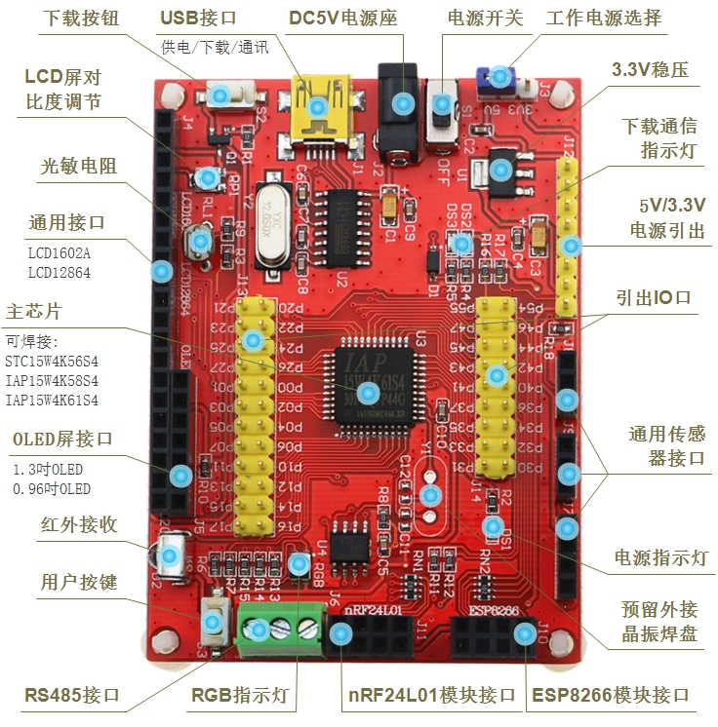
Microcontroller Pins and Functions
Package

Slide 45
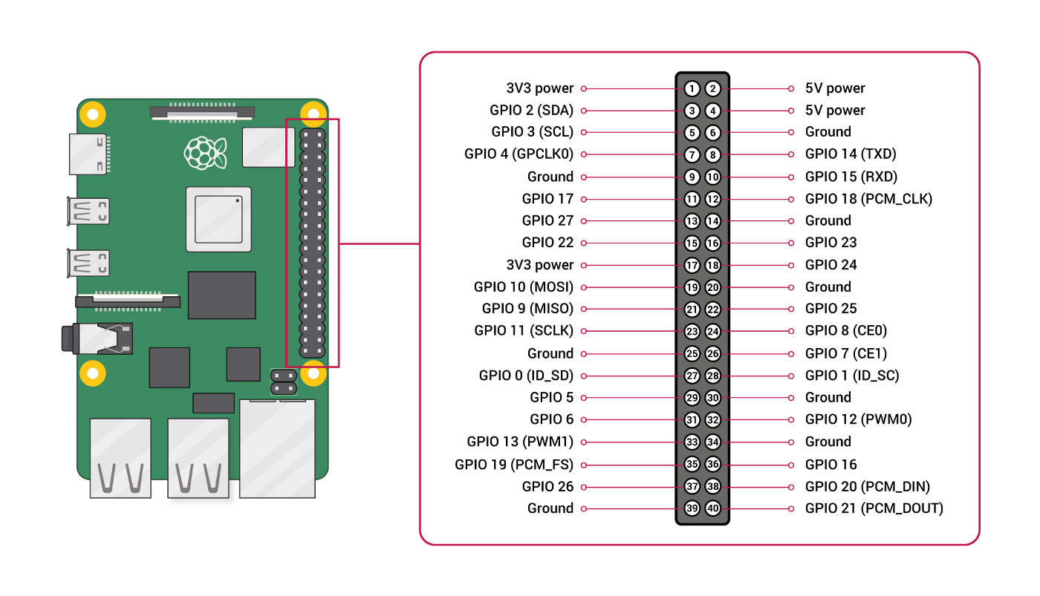
Broadcomm BCM2711

Slide 46
Microcontroller Pins and Functions
Compared to the LQFP-44 packaged microcontroller, the DIP-40 packaged IAP15W4K58S4 microcontroller is identical in all other resources, except for the absence of P4.0, P4.3, P4.6, and P4.7 pins.
Since DIP package microcontrollers are easier to solder, it is best for beginners to choose DIP package microcontrollers for learning.
Note: In practical applications, when designing the schematic diagram for a microcontroller application system, a logic symbol diagram should generally be used for circuit analysis. However, when designing the printed circuit board (PCB) layout for an application system, the microcontroller pin diagram must be used.
Minimum Function Board

Slide 47
Minimum Functional Board
Minimum Functional Board: Pins
Power supply pins
External crystal oscillator pins
Control and reset pins
Input/Output (I/O) pins
1.Power Supply Pins
VCC: Generally connected to +5V from the power supply. The specific voltage range should refer to the microcontroller's datasheet.
GND: Connect to power ground.

Slide 48
Microcontroller Pins and Functions
2. External Crystal Oscillator Pins
XTAL1 and XATL2
47pF
/P1.6
The input and output terminals of an internal inverting amplifier within the chip. Commonly used to connect a crystal oscillator.
/P1.7
47pF
The crystal oscillator frequency can be selected between 4MHz and 48MHz, with a typical value of 11.0592MHz (because when designing a microcontroller communication application system, using a crystal with this frequency can accurately achieve baud rates of 9600 bits/s and 19200 bits/s).

Slide 49
2. External Crystal Oscillator Pins
The IAP15W4K58S4 microcontroller integrates a high-precision R/C oscillator internally, and its operational clock can be sourced either from this internal oscillator or an external crystal oscillator.
The factory default configuration for the 40-pin and 44-pin packaged IAP15W4K58S4 microcontrollers uses an external clock. The integrated high-precision R/C oscillator has a temperature drift of ±1% in an industrial environment, and a temperature drift of 5‰ at room temperature. Its frequency range is 5MHz~35MHz, and it can be configured during programming. For applications where clock frequency accuracy is not highly critical, the internal R/C oscillator is perfectly sufficient.
When using the internal R/C oscillator as the clock source, the XTAL1 and XTAL2 pins should be left floating (unconnected).
When using an In-System Programming (ISP) tool to download user programs to the IAP15W4K58S4 microcontroller, you can choose in the options to use either the external crystal oscillator or the internal R/C oscillator as the clock source.

Slide 50


3. Control and Reset Pins
Power-on charging potential
RST (RESET) (Multiplexed with P5.4)
When the oscillator is running, a high level on this pin lasting for two machine cycles will reset the microcontroller.
If the microcontroller needs to reset automatically upon power-up, a power-on reset circuit can be used.
SS_3 /SYSCLKO /RST /P5.4
VPD:Backup power supply pin for traditional C51 microcontrollers

Slide 51
(2) RST Pin
The P5.4/RST/MCLKO SYSCLKO pin is factory defaulted as an I/O port. When downloading programs using STC-ISP programming software, it can be set as the RST reset pin.
The IAP15W4K58S4 microcontroller integrates a dedicated MAX810 reset circuit internally. When the clock frequency is below 12MHz, the reset pin can be connected via a 1K resistor to ground, or the traditional reset circuit shown in the diagram can also be used.

Slide 52
Microcontroller Input/Output (I/O) Pins
The IAP15W4K58S4 microcontroller in an LQFP-44 package can have up to 42 I/O lines:
P0 Port (8 pins): P0.0~P0.7
P1 Port (8 pins): P1.0~P1.7
P2 Port (8 pins): P2.0~P2.7
P3 Port (8 pins): P3.0~P3.7
P4 Port (8 pins): P4.0~P4.7
P5 Port (2 pins): P5.4, P5.5.
1. I/O Port Operating Modes
4 modes: Quasi-bidirectional / Weak Pull-up, Push-pull / Strong Pull-up, Input / High-impedance, and Open-drain modes. After reset, it defaults to Quasi-bidirectional / Weak Pull-up mode.
The operating mode of each port is controlled by corresponding bits in 2 control registers (PnM0 and PnM1, where n=0, 1, 2, 3, 4, 5, 6, 7).

Slide 53
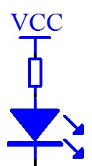
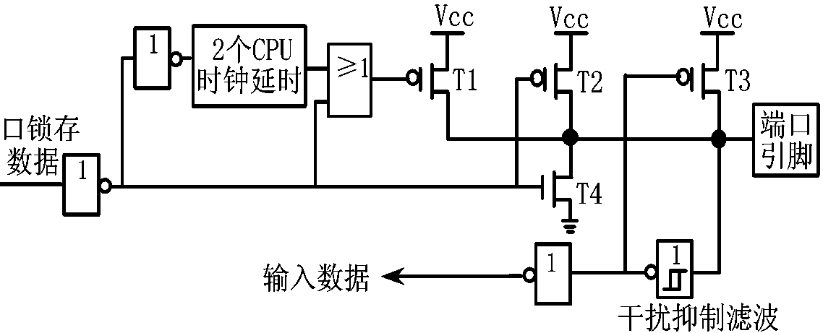
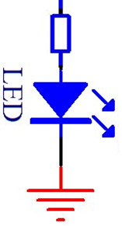
(1)Structure of the dual-directional (weak pull-up) working mode
The quasi-bidirectional port has 3 pull-up field-effect transistors (FETs), T1, T2, T3, to suit different needs. Among them, T1 is called strong pull-up, with a pull-up capability of up to 20mA; T2 is called extremely weak pull-up, with a typical pull-up capability of 30µA; T3 is called weak pull-up, with a typical pull-up capability of 150µA~250µA, a typical value being 200µA. When outputting a low level, the maximum sink current can reach 20mA.
20mA
30μA
200μA
strong
very weak
weak
2 CPU clock
delays
1
1
20mA
0
Port Data Latch
0
Port Pin
0
1
Any one port line of P0~P7
input data
Interference Suppression Filter

Slide 54

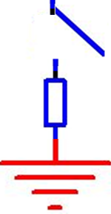
Structure of the dual-directional (weak pull-up) working mode
例 P1口 | P1.7 | P1.6 | P1.5 | P1.4 | P1.3 | P1.2 | P1.1 | P1.0
Each port contains a latch, which is a Special Function Register P0~P7. This structure provides a latching function during data output, meaning the data on the port line remains unchanged until new data is re-outputted.
However, input signals are not latched, so data input from peripheral devices must be maintained until the data read instruction is executed.
For convenience in description, from now on, all 8 port pins and their latches will be referred to as P0~P7.
Example: latch bit of P1.0 line
Port Data Latch
2 CPU clock
delays
0
20mA
1
0
1
Port Pin
1
0
P0～P7口的任一位口线
例:口线P1.0
CPU reads pin status data
example：P1.0 line
input data
schmmit trigger
Any port line from P0 to P7
Interference Suppression Filter

Slide 55
Structure of the dual-directional (weak pull-up) working mode
Each I/O port of the IAP15W4K58S4 microcontroller in weak pull-up mode can withstand a sink current of 20mA (it's best to use a current-limiting resistor, such as 1KΩ)
The recommended operating current for the entire chip should not exceed 90mA. That is, the current flowing into MCU-Vcc should not exceed 90mA, the current flowing out of MCU-GND should not exceed 90mA, and the total inflow/outflow current should not exceed 90mA.
20mA
30μA
200μA
P0～ P7
strong
very weak
weak
Port Data Latch
2 CPU clock
delays
0
1
Port Pin
0
At low output, the maximum sink current is 20mA
例:口线P1.0
Example: Mouth line P1.0
input data
Interference Suppression Filter

Slide 56

Structure of the dual-directional (weak pull-up) working mode
When the latch is 1 and the port line pin itself is also 1, T3 is turned on. T3 provides the basic drive current to make the quasi-bidirectional port output 1.
If the pin outputs "1" and is pulled low by an external device, T3 turns off, while T2 remains on. To forcibly pull this pin low, the external device must have sufficient sink current capability to drop the voltage on the pin below the threshold voltage.
1
1
20mA
30μA
例:口线P1.2
1
strong
very weak
weak
P0～P7
200μA
Port Data Latch
off
on
off
on
1
0
2 CPU clock
delays
0
1
Port Pin
例:口线P1.2的锁存器位
input data
Example: latch bit of P1.2 line
Interference Suppression Filter

Slide 57
Structure of the dual-directional (weak pull-up) working mode
When the latch is 1, T2 and T3 are turned on. The pin outputs a high level.
When latch is 0, T1, T2, and T3 are all cut off, T4 is turned on, and the pin outputs a low level.
例:口线P3.2
Example: latch bit of P3.2 line
1
1
20mA
30μA
200μA
1
strong
very weak
weak
P0～P7
Port Data Latch
0
0
1
off
on
on
1
2 CPU clock
delays
off
off
0
0
Port Pin
1
1
off
on
At low output, the maximum sink current is 20mA
0
例:口线P3.2的锁存器位
Example: latch bit of P3.2 line
input data
Interference Suppression Filter

Slide 58
Structure of the dual-directional (weak pull-up) working mode
When the latch toggles from 0 to 1, T1 accelerates the quasi-bidirectional latchs transition from logic 0 to logic 1. During this process, T1 conducts for approximately two clock cycles, enabling the pin to rapidly pull up to a high level.
The bidirectional switch has a Schmitt trigger input and an interference suppression circuit.
Delay 2 clock cycles to 1
1
1
1
20mA
30μA
200μA
strong
Very weak
weak
P0～ P7
0
0
1
Port Data Latch
remain 0
for 2 clock cycles
Off
Off
1
2 CPU clock
delays
Off
remain on
for 2 clock cycles
On
On
0
0
0
1
Port Pin
Example: latch bit of P3.2 line
Off
On
Example: P3.2
1
1
0
input data
CPU reads pin status data
Interference Suppression Filter

Slide 59
Structure of the dual-directional (weak pull-up) working mode
The I/O port can be used for both output and input functions without reconfiguring the port line output status (4 working modes).
When the port output latch is set to 1, the I/O ports high-level drive capability becomes very weak.
Allow external devices to pull it down (that is, allow low input, at which time T3 and the Schmitt trigger tube form positive feedback, the pin is clamped at 0 level, low input).
1
1
30μA
200μA
1
20mA
Very weak
strong
weak
P0～ P7
Example: P1.2
Port Data Latch
On
On
1
2 CPU clock
delays
off
off
0
0 input
0
1
Port Pin
Example: latch bit of P1.2 line
The CPU can now read the pin status data
input data
The pin status can be high or low.
Interference Suppression Filter

Slide 60
Structure of the dual-directional (weak pull-up) working mode
When data is input from the port pins, T4 should remain in the cutoff state.
Assuming that data 0 is latched before the input, T4 is turned on, and the pin potential is clamped at the 0 level, so that the input high level cannot be read.
Therefore, as a quasi-dual-port application, when inputting data, it is necessary to first write 1 to the port to cut off T4, and then the high impedance input can be made. This is the main feature of the quasi-dual-port.
20mA
30μA
200μA
strong
Very weak
weak
P0～ P7
Port Data Latch
off
On
1
off
2 CPU clock
delays
0
0
1
0
0
1
Port Pin
1
0
off
Example: latch bit of P3.2 line
off
On
outside
Enter 0
CPU reads pin status data
input data
Keyboard interface circuit (with current-limiting resistor) commonly operates in quasi-dual-port mode
Interference Suppression Filter

Slide 61
Implementation of a simple keyboard interface
MCU
The programming learning platform implements matrix keyboard key scanning and displays the results on digital LED.

Slide 62
Implementation of a simple keyboard interface
For example, the 8 I/O lines of port P2 can be arranged in a 4×4 matrix to connect 16 buttons, as shown in the figure.
4×4 matrix keyboard circuit
300Ω×8

Slide 63
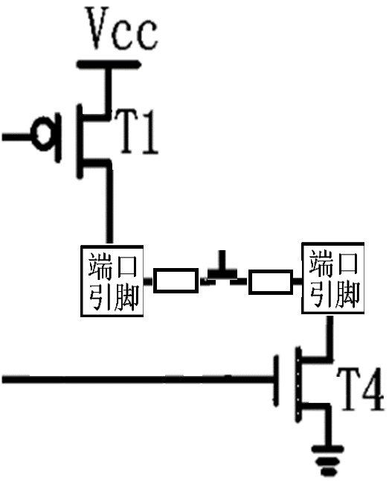
(3) Pull current mode and push current mode
If the matrix key scanning circuit lacks a current-limiting resistor, it may damage the I/O port. This can be prevented by connecting the weak pull-up pins P2.0 and P2.4 to the key via a circuit. The configuration involves connecting the source of transistor T1 on P2.0 and the drain of transistor T4 on P2.4 to the key through the key and current-limiting resistor, while ensuring the output from P2.0 and P2.4 remains at a low voltage level.
To read the status of P2.4 via the P2.0 port, the port must first output a 1. When the P2.0 port transitions from 0 (initial state) to 1, T1 will conduct for two clock cycles.
If the current-limiting resistor is omitted, it is equivalent to the T1 transistor at P2.0 and the T4 transistor at P2.4 being short-circuited to the power supplys positive and negative terminals simultaneously. This creates a high current that could damage the I/O port. Therefore, the two pins of the microcontroller should not be directly short-circuited.
T1 for P2.0 port
0
key
1
current-limiting resistance
T4 for P2.4 port

Slide 64
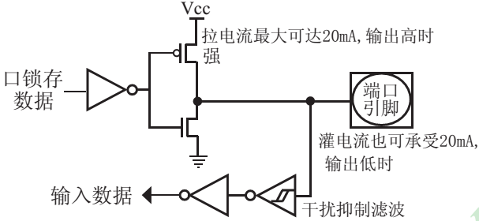

(2) Architecture of push-pull output (strong pull-up output) operating mode
The push-pull output can output 20mA pull current (also need to add current limiting resistor).
The recommended operating current for the entire chip should not exceed 90mA. Specifically, the current flowing into MCU-Vcc and out of MCU-GND must not exceed 90mA, and the total current entering or exiting the system must also not exceed 90mA.
When the output is high, the pull current can reach up to 20mA
Example: latch bit of P3.2 line
strong
Example: P3.2
Port Pin
Port Data Latch
Push-pull output (strong pull-up output)
At low output, the maximum sink current is 20mA
input data
Interference Suppression Filter

Slide 65
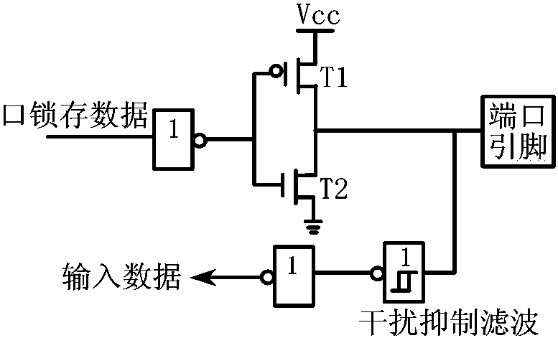
(2) Architecture of push-pull output (strong pull-up output) operating mode
Structure of push-pull output mode
1
on
1
0
Example: P3.2
off
Port Data Latch
off
0
Example: latch bit of P3.2 line
0
1
Port Pin
on
input data
Interference Suppression Filter
Input/output bit structure for push-pull output mode

Slide 66
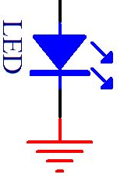
(2) Architecture of push-pull output (strong pull-up output) operating mode
The pull-down structure in push-pull output mode is identical to that of a quasi-dual-port, but provides sustained strong pull-up when the latch is set to 1. This push-pull mode is typically employed where higher drive current is required.
If the output is high, the pull current can reach up to 20mA;If the output is low, the sink current can also reach 20mA.
The push-pull output mode also features a Schmitt trigger input and an interference suppression circuit.
When the output is high, the pull current can reach up to 20mA
Example: P3.2
1
1
0
Example: latch bit of P3.2 line
Port Data Latch
1
0
0
Port Pin
At low output, the maximum sink current is 20mA
input data
Interference Suppression Filter

Slide 67

2. Architecture of I/O ports in the IAP15W4K58S4 microcontroller
(3) Structure for input-only (high-impedance) operation mode
The input port has a Schmitt trigger input and an interference suppression circuit.
Note: The I/O port does not support 20mA sink/drain current capability in input (high-impedance) mode only.
Example: P3.2
input data
CPU reads pin status data
Port Pin
Interference Suppression Filter
Input (high-impedance) mode I/O bit structure

Slide 68
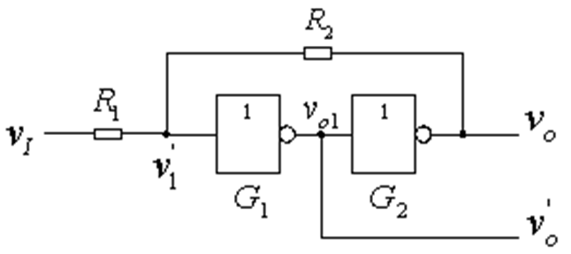
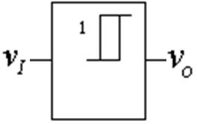
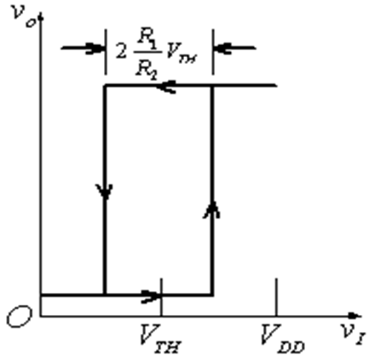
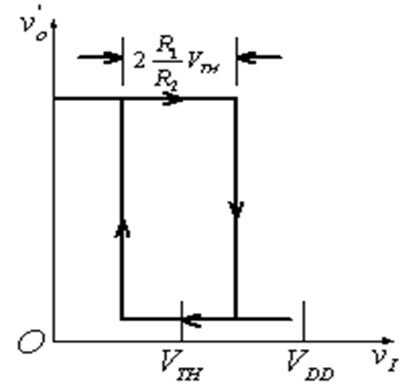
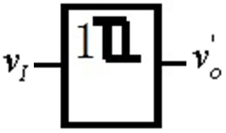
External bus interface level conversion technology (supplement)
A Schmitt trigger composed of CMOS inverters
Schmitt trigger with in-phase output
Inverting Schmitt trigger
VT-
VT+
VT-
VT+
Convert level

Slide 69
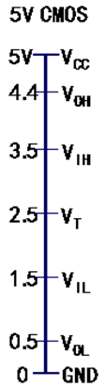
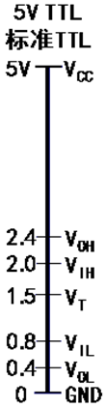
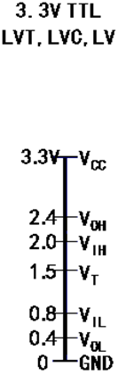
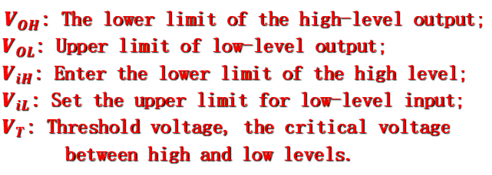
External bus interface level conversion technology (supplement)
Common signal level conversion standards
$V_{OH}$: The lower limit of the high-level output;
$V_{OL}$: Upper limit of low-level output;
$V_{iH}$: Enter the lower limit of the high level;
$V_{iL}$: Set the upper limit for low-level input;
$V_{T}$: Threshold voltage, the critical voltage between high and low levels.
5 V TTL and 3.3 V TTL: Same conversion standard
Interface problem: 3.3. Can TTL withstand higher input voltages than the power supply voltage?
3 .3 V TTL and 5V CMOS: Level matching issues exist
Figure Common signal level conversion standards

Slide 70
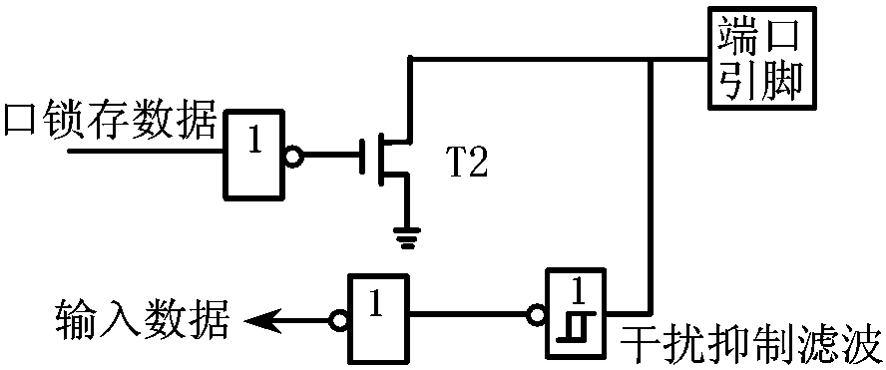
2. Architecture of I/O ports in the IAP15W4K58S4 microcontroller
Vcc
When outputting through the output line, the external circuit must be connected to the positive power supply via a pull-up resistor.
(4) Structure of open drain output mode
Vcc
No pull-up configuration for the positive power supply terminal
Port Pin
Example: P3.2
Example: latch bit of P3.2 line
Port Data Latch
input data
Interference Suppression Filter
Figure 3-18 I/O bit structure for open drain output mode

Slide 71
(4) Structure of open drain output mode
This configuration requires an external pull-up resistor connected to Vcc. When the port latch is at 0, T2 is activated.
This type of pull-down structure is the same as the pull-down structure in the quasi-dual-port mode.
The sink current can reach 20mA when the output is low.
When the output is high, the drive current does not flow through the microcontroller, and there is no load limit.
The open drain port has a Schmitt trigger input and an interference suppression circuit.
Vcc
1
Example: P3.2
1
0
Example: latch bit of P3.2 line
off
0
Port Pin
Port Data Latch
1
At low output, the maximum sink current is 20mA
0
on
input data
Interference Suppression Filter

Slide 72
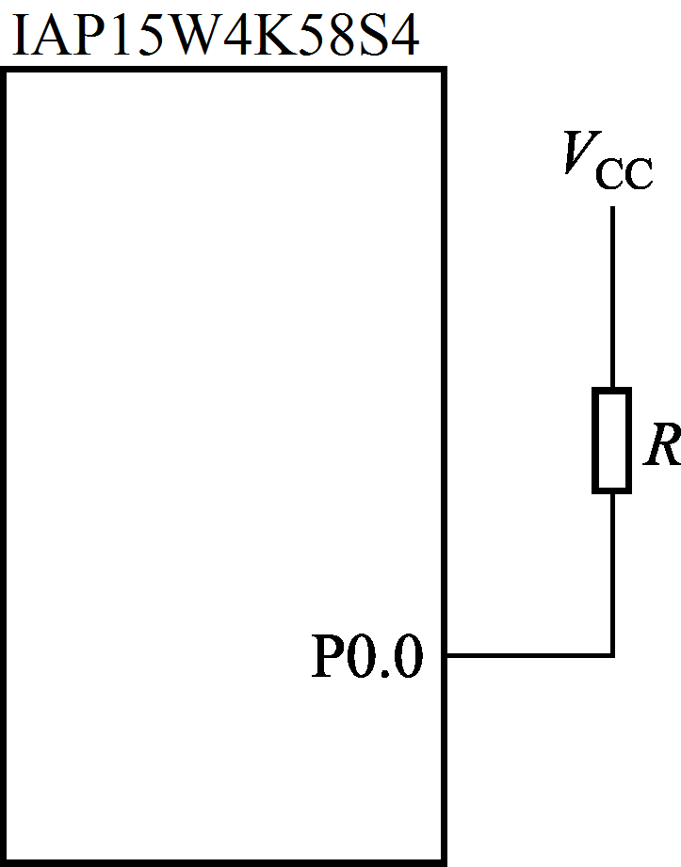
4. The use of I/O ports in IAP15W4K58S4 microcontroller
(1) Use of P4 and P5 ports
The access to the P4 and P5 ports of the IAP15W4K58S4 microcontroller is the same as accessing the regular P0/P1/P2/P3 ports, and can be addressed bit by bit. The address of the P4 port is C0H, and the address of the P5 port is C8H.
(2) Connection of pull-up resistor
Although a pull-up field-effect transistor is integrated inside the microcontroller when used as a quasi-bidirectional port, in practical applications, for example, when an external circuit with open drain such as SPI/I2C is connected, it is generally better to connect an external pull-up resistor.
Taking P0.0 as an example, the circuit connection is shown in the figure. The typical pull-up resistor resistance is 5.1 KΩ or 10 KΩ.

Slide 73
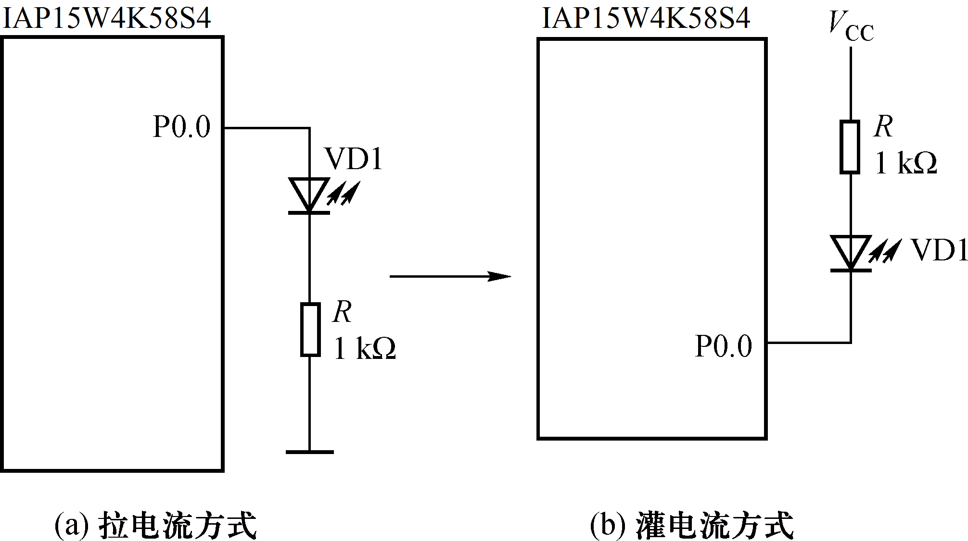
(3) Source Current Mode and Sink Current Mode
The I/O port of IAP15W4K58S4 microcontroller can provide a driving capability of 20mA as output.
When in use, it can be source current mode or sink current mode.
Taking P0.0 control of the LED circuit as an example, the circuit connection is shown in the figure.
The driving current of the light-emitting diode is approximately several mA to 20mA.
Output high-level light on
Weak pull-up/quasi-bidirectional port working mode
Note:
The current limiting resistor in the diagram cannot be omitted, otherwise it will damage the I/O port.
Push-pull output/strong pull-up working mode
Output low-level light on
(a) Source Current Mode
(b) Sink Current Mode
Figure 3-20 Source Current Mode and Sink Current Mode

Slide 74
(3) Source Current Mode and Sink Current Mode
When using the Sink Current Mode, the I/O port of the microcontroller should be set to weak pull-up/quasi-bidirectional port working mode;
When using the Source Current Mode, the I/O port of the microcontroller should be set to push-pull output/strong pull-up working mode.
In practical use, the Sink Current Mode should be used as much as possible to improve the load capacity and reliability of the system.
Note: Add a current limiting resistor
When designing a row column matrix key scanning circuit, like the I/O port line driving indicator light above, a current limiting resistor needs to be added on both sides of the key scanning circuit, with a current limiting resistor of 300 Ω each. Otherwise, the I/O port will be damaged.

Slide 75
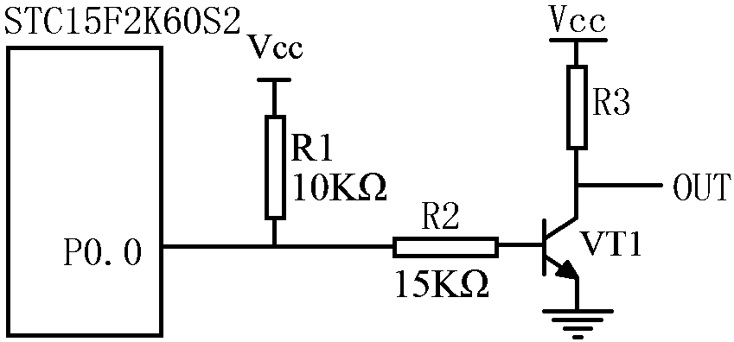
(4) A Typical BJT Control Circuit
The driving capability of the microcontroller I/O pins is limited. If high-power devices such as small relays or solid-state relays need to be driven, the microcontroller I/O pins can be used to control the BJT for output. Taking P0.0 as an example.
If weak pull-up control is used, it is recommended to add a pull-up resistor R1(3.3KΩ ~10KΩ).
If the resistor R1 is not added, it is recommended that the R2 value be above 15KΩ, or use strong push-pull output.
IAP15W4K58S4
The base current of a BJT I_{B} is in the tens of μA range
Figure 3-21 A Typical BJT Control Circuit

Slide 76
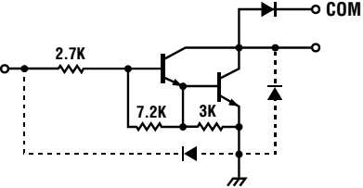
(4) A Typical BJT Control Circuit
When there are many power devices that need to be driven, it is recommended to use ULN2803 (18 pins, or 16 pins ULN2003, produced by companies such as TI and ST), it adopts a Darlington structure internally and is a chip specifically used to drive relays. Even a diode that eliminates the back electromotive force of the coil is made inside the chip.
The output terminal of ULN2803 allows for an IC current of 600mA and a withstand voltage BV_{CEO} of approximately 50V.
The output terminal of ULN2003 allows an IC current of 200mA (maximum 500mA), with a saturation voltage drop V_{CE} of about 1V (at 200mA) and a withstand voltage BV_{CEO} of about 50V.
The external load of the output port can be estimated based on the above parameters. Adopting open collector output with high output current, it can directly drive relays or solid-state relays (SSR).
ULN2003 (ULN2803) can drive 7(8) relays.

Slide 77
1. Minimum System Composition of Single Chip Microcomputer
In order to download programs to the microcontroller, RS232 and TTL conversion circuits can be connected to the RXD and TXD pins, which can be used to connect to a computer and download user programs to the microcontroller through a download tool.
RS232 serial port has a negative logic level: +5~+12V is a low level 0, while -12~-5V is a high level 1
STC15W series supports direct download of programs via USB interface
Connect the computer serial port
The serial port of the microcontroller is TTL level
Connect the P3.0 and P3.1 pins of the microcontroller separately
MAX232, MAX3232,
SP232 or SP3232
Figure 3-23 RS232 and TTL Conversion Circuit

